Slide 1
Rudder and Tail
Notes:
5 mins Ice Breaker
Introduce them to the problem → for this probably the moments? Figure out how much lift it needs to product
Compare it to how much it actually produces → Flat Plate Airfoil
Fully explain the background behind every physics problem

Slide 2
Agenda
5 min — ice breaker
10 min — intro to tail
10 min — static stability explanation
10 min — center of gravity
Notes:
Alex

Slide 3
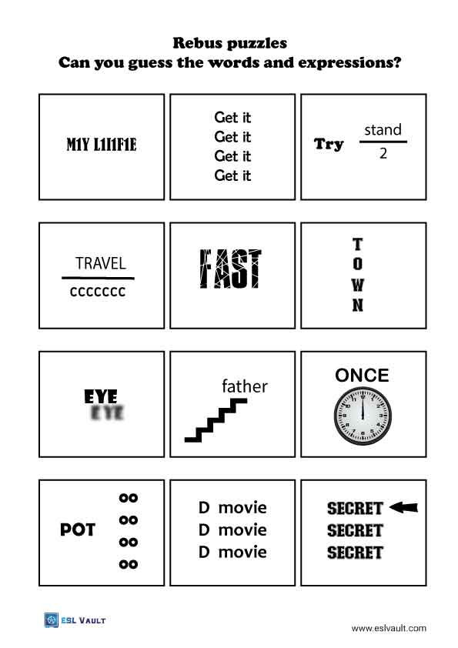

Slide 4
Ice Breaker:
2 minutes - what is the purpose of a tail on a plane?
Share out at the end!
Notes:
Alex

Slide 5
What are control systems and how do they work?
Control systems enable the pilot to control the movement of the aircraft, and the 3 systems in our aircraft are the:
Rudder: Allows for rotation around the vertical axis
Ailerons: Allows for rotation along the longitudinal axis
Elevators: Allows for rotation along the lateral axis
On ultralights, is controlled by wires, but differs from plane to plane
Notes:
Sheelyn

Slide 6
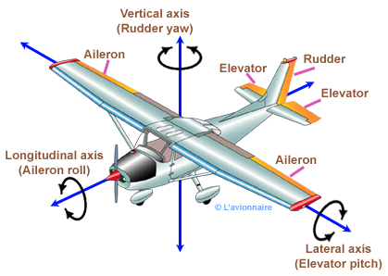
Rotation along these 3 axis gives the pilot control of the direction of the plane with yaw (rudder), roll ( aileron ), and pitch (Elevator).
When a control system is slightly tilted to one side, a difference in lift or drag is created, turning the plane.
Notes:
Alex

Slide 7
Question!
What is a chord?
The length you get when you wrap a string around the perimeter of an airfoil
The largest amount of lift an airfoil can produce
The line from front tip (leading edge) to back tip (trailing edge) of an airfoil

Slide 8
Answer:
c

Slide 9
Question!
How do planes produce lift?
Two particles want to be together and the top must speed up to catch the bottom
The wing goes so quickly that gravity doesn’t affect it as much
No one really knows, but there’s low pressure at the top of the wing and high pressure at the bottom

Slide 10
Answer:
c

Slide 11
Question!
1 pt: If the pilot wants to increase pitch (tilt the airplane’s nose up), what should they do?

Slide 12
Answer:
Raise the elevators

Slide 13
Question!
1 pt: If the pilot wants the airplane to roll to the right, what should they do?

Slide 14
Answer:
Raise right aileron, lower left

Slide 15
Question!
1 pt: If the pilot wants to decrease pitch (tilt the airplane’s nose down), what should they do?

Slide 16
Answer:
Lower the elevators

Slide 17
Question!
1 pt: If the pilot wants the airplane to roll to the left, what should they do?

Slide 18
Answer:
Raise left aileron, lower right aileron

Slide 19
Challenge Question!
2 pts: If the pilot wants to turn the airplane right, what should they do?

Slide 20
Answer:
Raise the right aileron, lower the left aileron, and turn the rudder right

Slide 21
Challenge Question!
2 pts: If the pilot wants to turn the airplane left, what should they do?

Slide 22
Answer:
Raise the left aileron, lower the right aileron, and turn the rudder left.

Slide 23
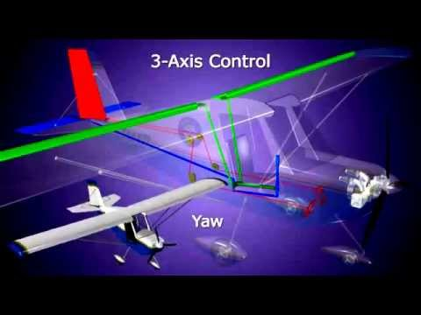
Their purpose
Notes:
Sheelyn

Slide 24
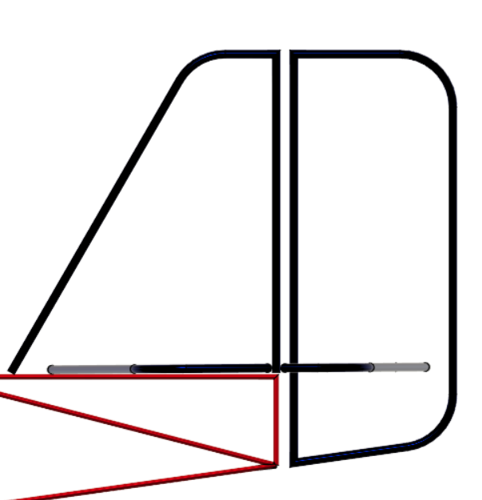
Rudder on our plane
Uses a bellcrank and cables to turn
When pulled right, causes the plane to turn right (more drag), and vice versa
Notes:
Alex

Slide 25
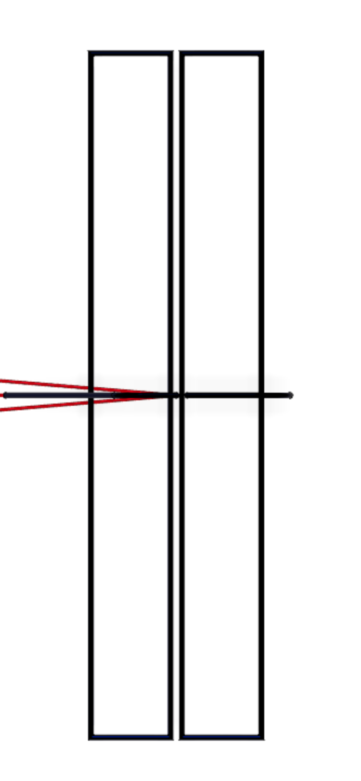
Elevator on our plane
When tilted up, causes less lift and more drag, which tilts the plane up
When tilted down, creates more lift and drag, which tilts the plane down.
Notes:
Sheelyn

Slide 26
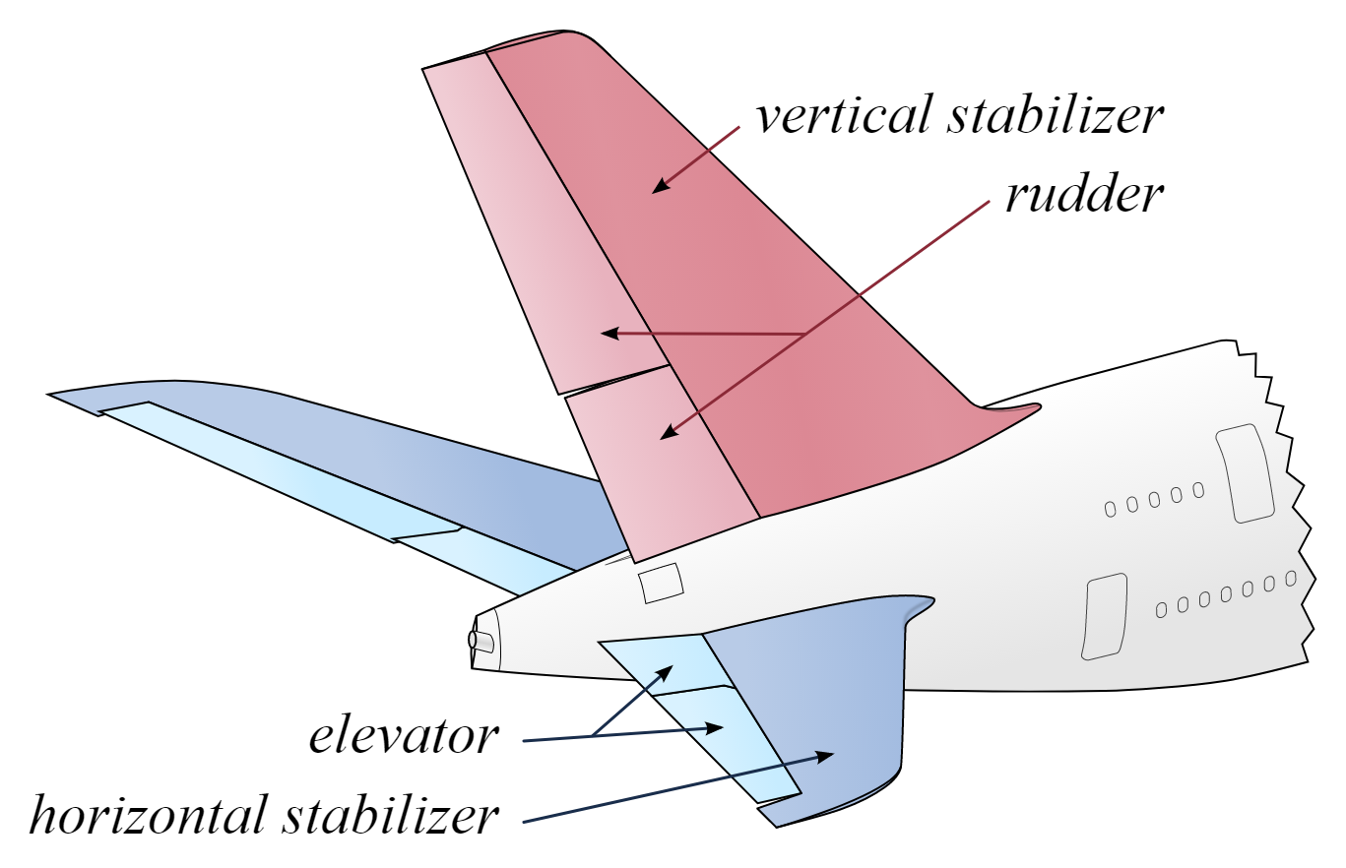
Stabilizers
Notes:
Alex

Slide 27
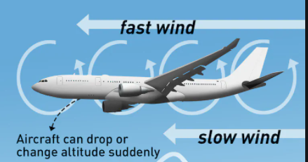
Purpose
Counters against unwanted motion:
Horizontal vs up and down
Vertical vs side to side
Turbulence:
Notes:
Sheelyn

Slide 28
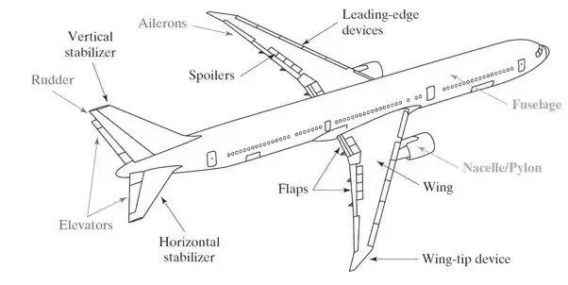
Question!
What part of the tail resists unwanted up and down motion?
Notes:
Alex

Slide 29
Answer:
Horizontal Stabilizer!
Notes:
Alex

Slide 30
Trivia Time!

Slide 31
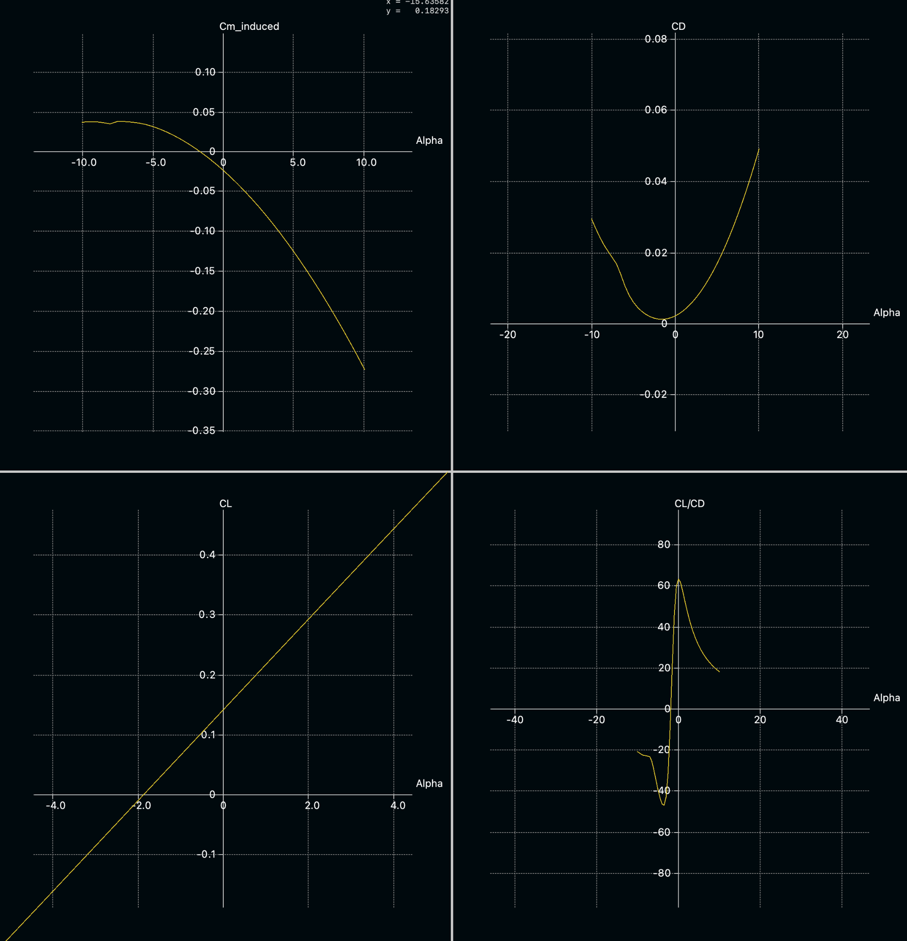
Alpha = Angle of attack (degrees) — positive AOA means the nose is tilted up, negative AOA means the nose is tilted down
Positive Cm_induced means the nose will pitch up, negative Cm_induced means the nose will pitch down
An aircraft that is statically stable will return to the original angle of attack if the angle of attack is changed
Is the aircraft that produced this graph statically stable?
Notes:
Answer = yes

Slide 32
Why we need a tail
Notes:
Alex

Slide 33
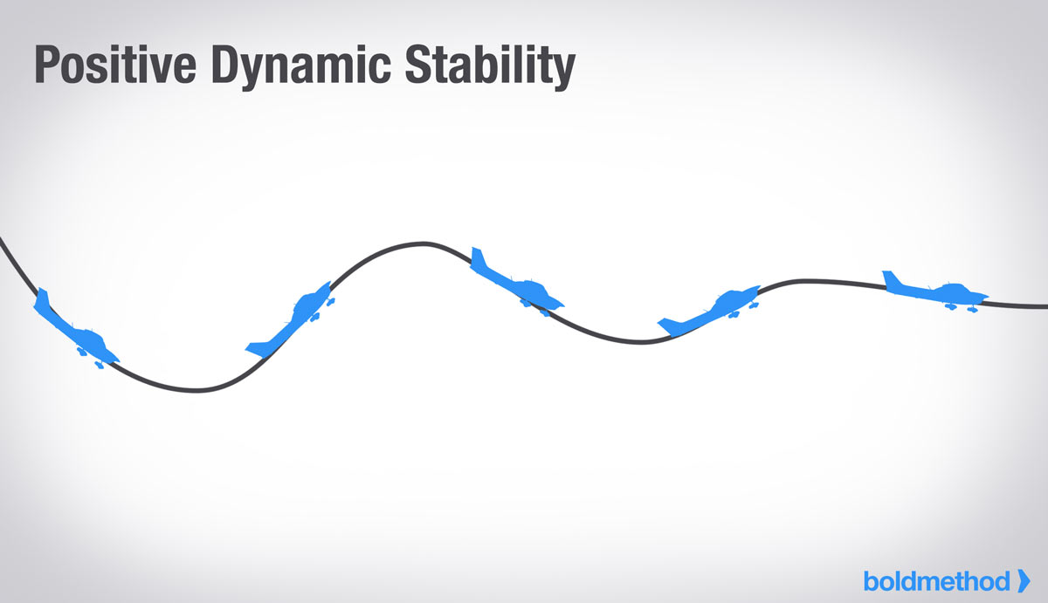
Static Stability
Basically, you want the plane to resist a change in angle of attack (or else things would get bad very fast).
Notes:
Alex

Slide 34
Remember: everything rotates around center of gravity
Ideally, when the wing is at the wrong AOA the tail will produce more or less lift to correct it
Ex. The wing’s AOA is too high, the tail should produce more lift relative to the wing to tilt the whole plane down.
Notes:
Maya

Slide 35
Static stability is represented by the negative curve on the graph — the more the plane tips away from the set AOA, the more force to correct it.
Notes:
Alex

Slide 36
How to achieve static stability
Tail AOA must be less than wing AOA (in our case, it must be negative).
Tail area must be decently large, empennage must be decently long.
*our plane uses a negative camber airfoil
Notes:
Maya

Slide 37
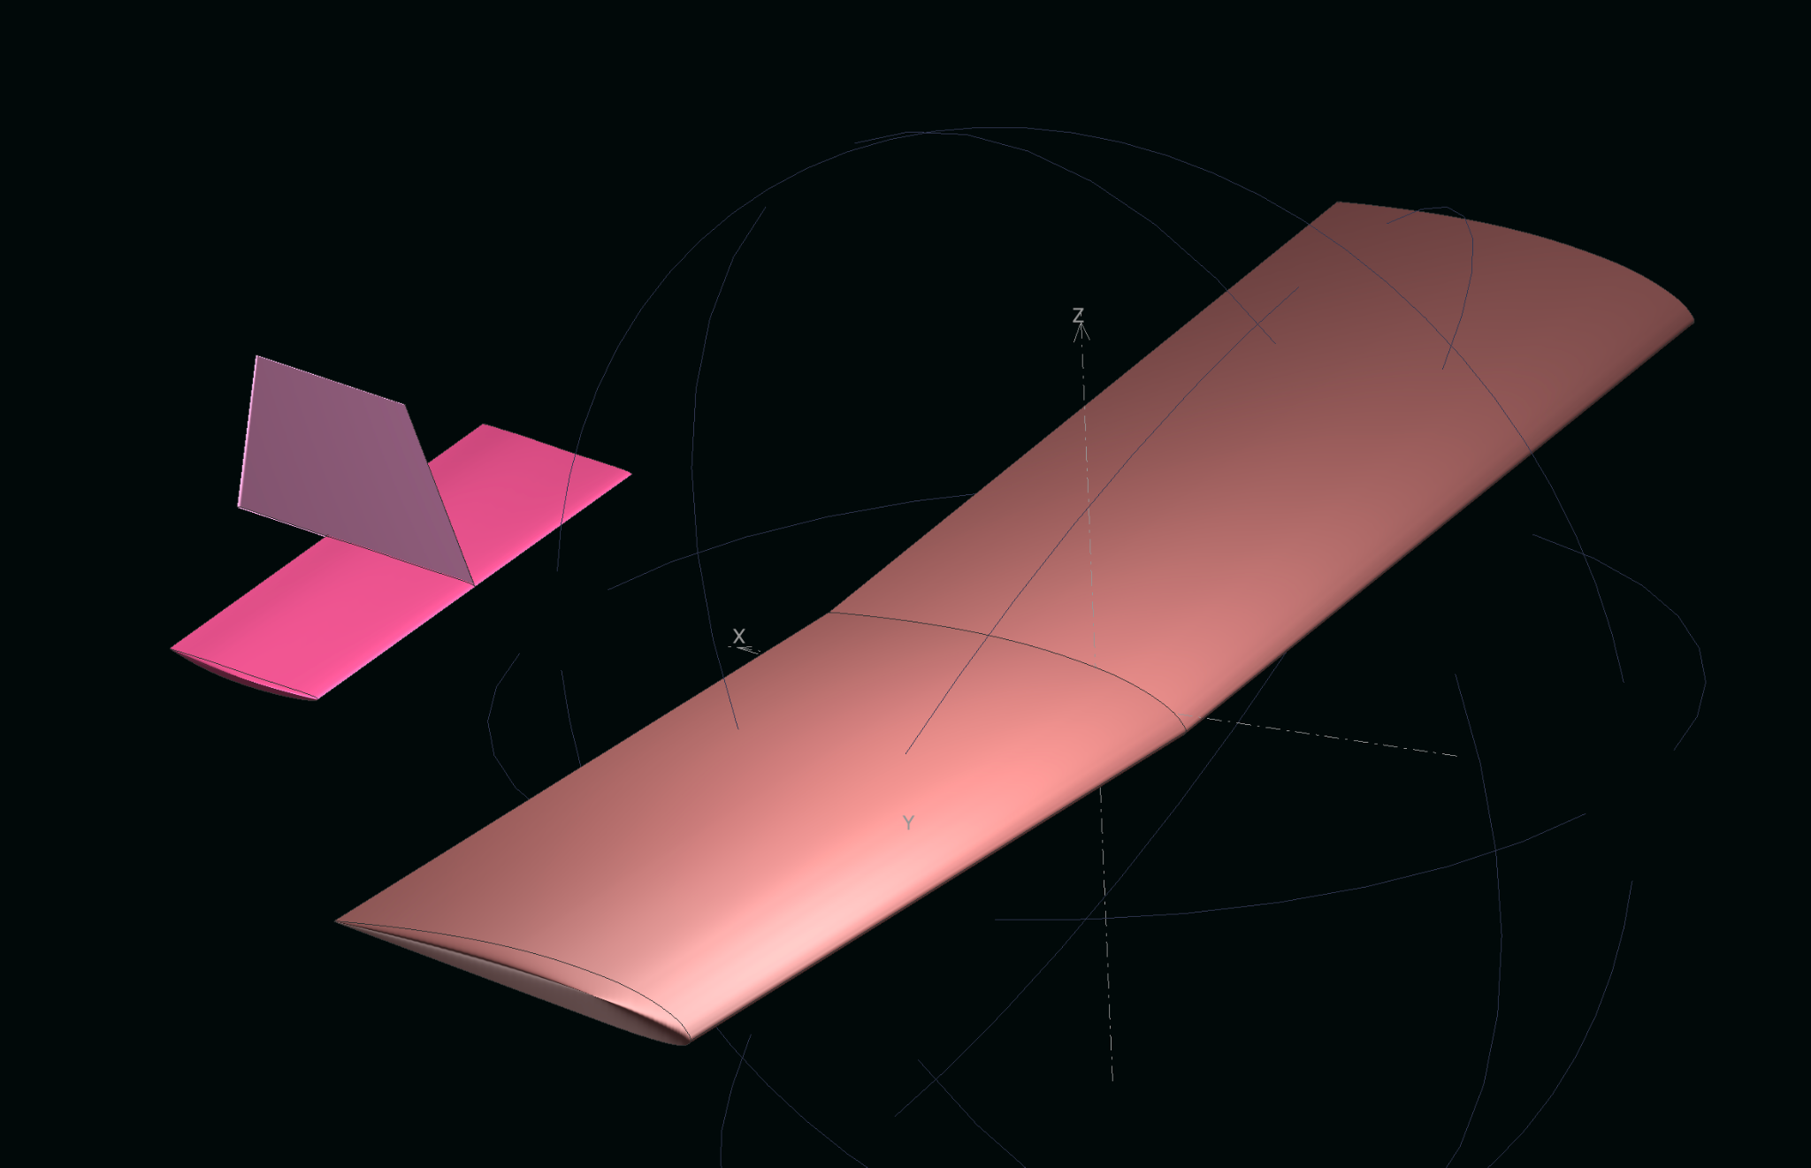
Our design in XFLR5
Notes:
Alex

Slide 38
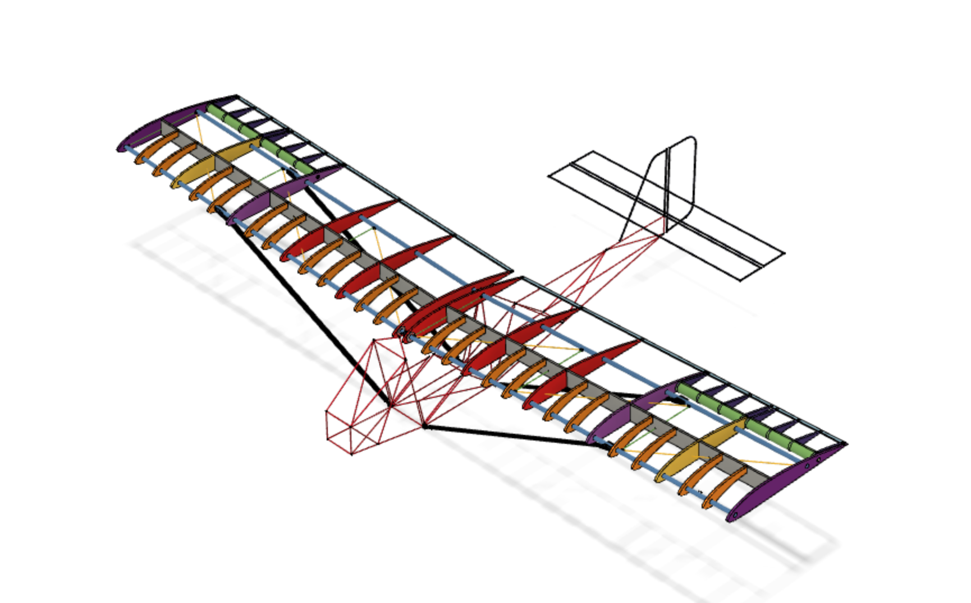
Our design in Fusion
Notes:
Alex

Slide 39
Question:
If tail area is kept the same, will a long, skinny tail be better or will a fat, short tail be better? Why?
Notes:
Maya

Slide 40
Answer:
A long, skinny tail (high aspect ratio), to minimize induced drag (remember this from the wing presentation?)
Notes:
Maya

Slide 41
Center of Gravity
Everything rotates around center of gravity, so if you want the tail to have the most effect (the most moment), you need center of gravity to be closer to the wing than it is to the tail.
Our CG is in front of our wing because our tail produces negative lift.
Notes:
Alex

Slide 42
Build a Plane
Follow these instructions to create the paper airplane: https://www.origamiway.com/plane-nakamura-lock.shtml
Notes:
Maya

Slide 43
Now throw it! Notice how it stalls?
Notes:
Alex

Slide 44
Fixing CG
Add a small paper clip to the front of the plane and try throwing it again. It shouldn’t stall this time.
Notes:
Alex

